Slide 1

Voter Prediction
Kushal Ismael, Divya Parmar, Bradley Reardon

Slide 2
01
Introduction
Table of Contents
02
Dataset Overview
03
EDA & Preprocessing
04
Modeling
05
Results
06
Conclusion
07
GUI Demonstration

Slide 3
Introduction
01

Slide 4
Project Overview
Using machine learning classification techniques, we predict which candidate a voter plans to vote for based on self-reported survey data.
We chose this dataset because the topic is highly relevant, there was an opportunity to apply EDA and preprocessing to a large number of features, and the dataset was mostly clean and well-documented courtesy of FiveThirtyEight.

Slide 5
Dataset Overview
02

Slide 6


Dataset Source
An American data journalism website that focuses on opinion poll analysis, politics, economics, sports, and predictive models
A multinational market research and consulting firm

Slide 7
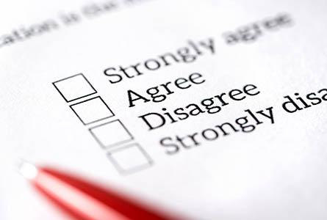
Dataset Overview
Nonvoters Survey Question Subjects
What it means to be a good American
Level of agreeance towards systemic racism statements
Faith (or lack thereof) in the US Government
How affected one feels by government policy making
Thoughts on voting, and past voting actions
Demographic information
Dataset Structure
5,836 observations
199 features – all categorical
Target Feature
Question 23 – “Which presidential candidate are you planning to support?”
Possible answers: “Donald Trump”, “Joe Biden”, “Unsure”
Notes:
Recording: maybe give an example of a question per topic

Slide 8

EDA & Preprocessing
03

Slide 9

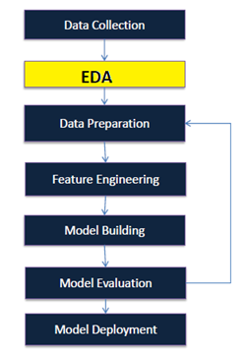
EDA
Cleanup
Renamed features to increase readability
Dropped 23 features that had only partial responses (i.e. “Which type of Republican are you?” would be null for Democrats in the sample)
Visualization
Added Age_Group feature to see distribution of non-voters by age group
Plotted demographic information (race, gender, education, etc) to check for balance

Slide 10
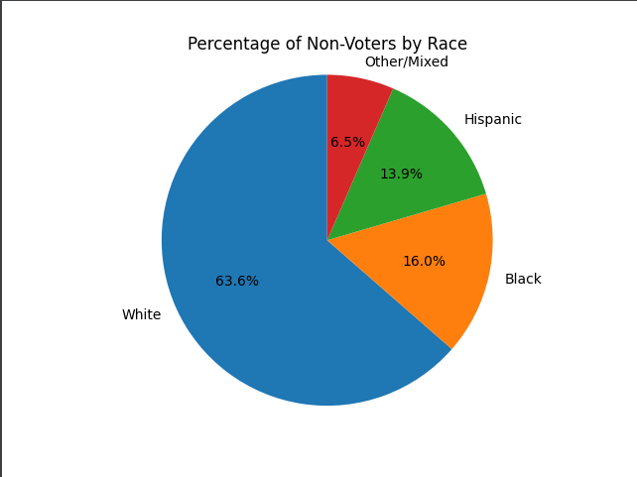
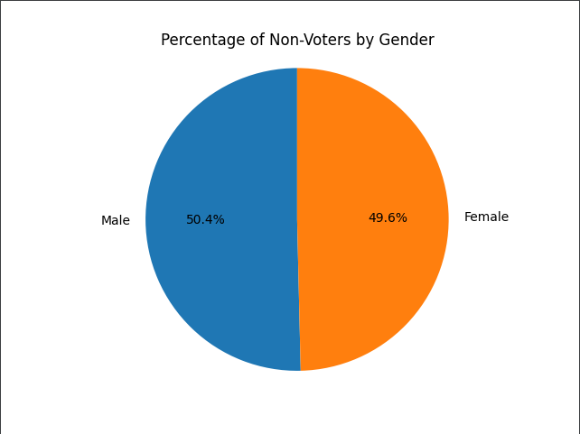
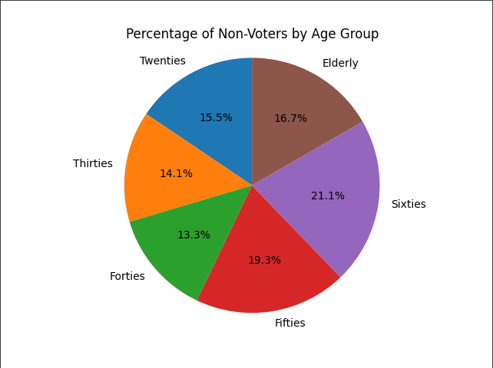
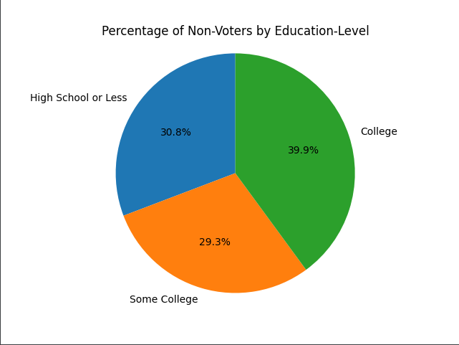
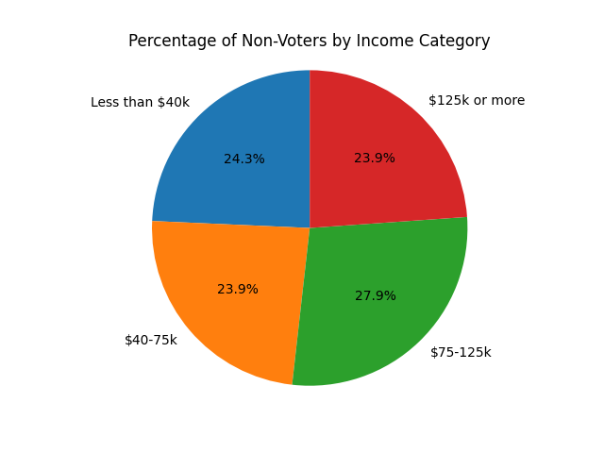
Normality Check – Pie Charts

Slide 11
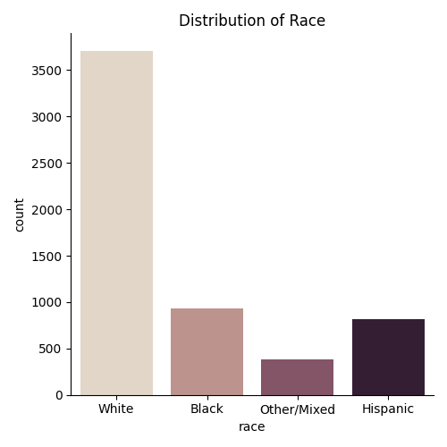
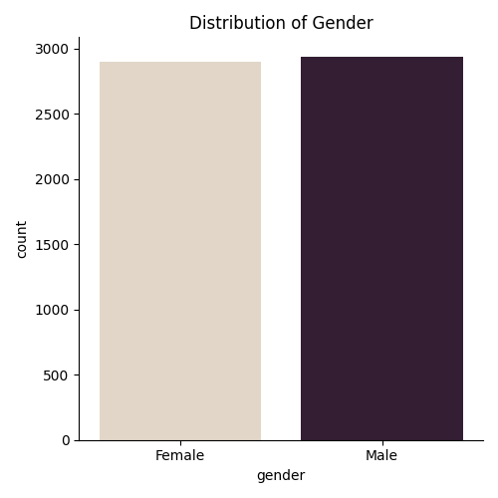
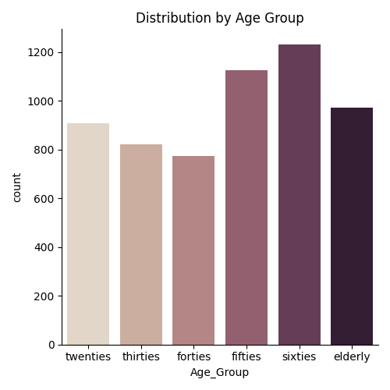
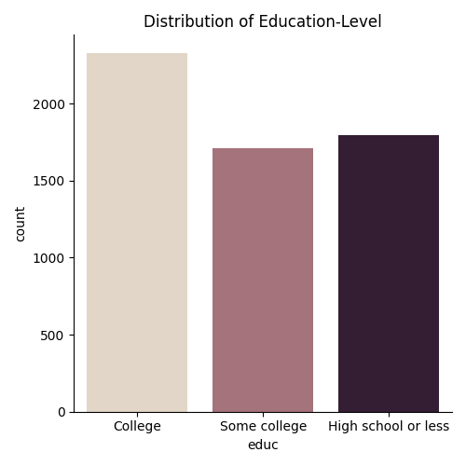
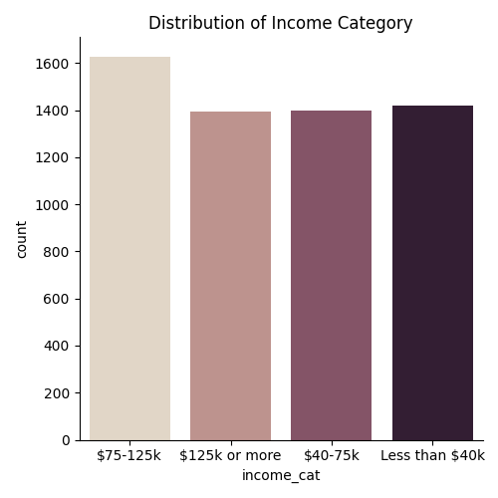
Normality Check – Histograms

Slide 12
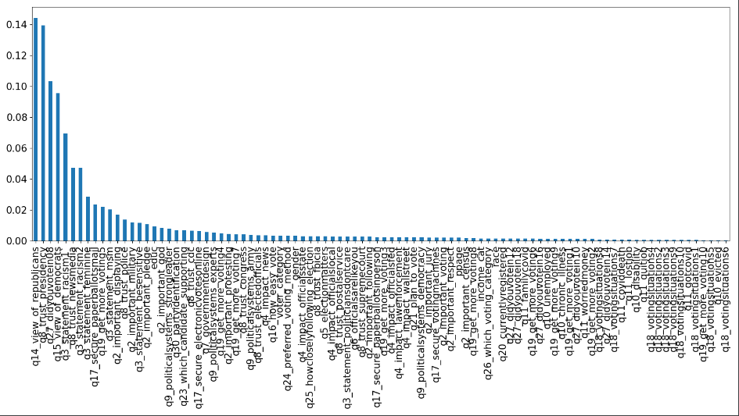
Preprocessing
Label encoded categorical features
Dropped observations where person supported third-party candidate or refused to answer
Replaced non-answers with the mean response of the individual’s demographic group
Calculated feature importance
Dropped features that were direct proxy for our target variable (“What is your view of Republicans?”, “Do you trust the presidency?”)
Feature Importance

Slide 13
Modeling
04

Slide 14
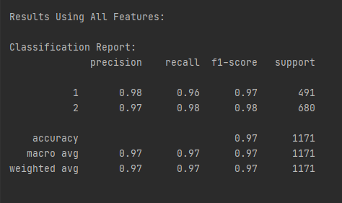
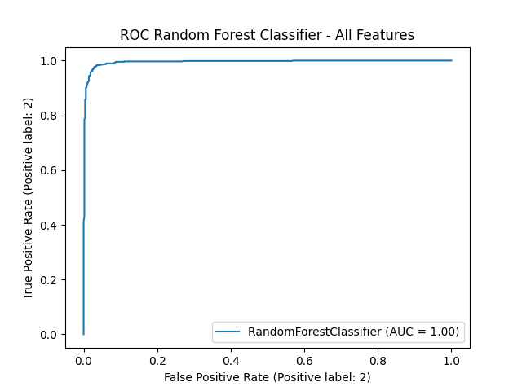
Random Forest Classifier
Model 1 Specifications - Full Model
Standard random forest classifier
Trained on full dataset
N estimators = 500

Slide 15
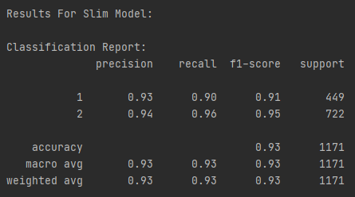
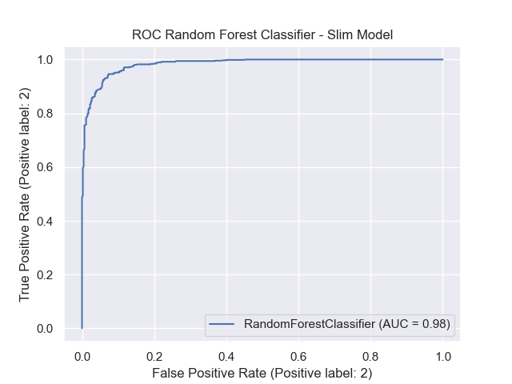
Random Forest Classifier
Model 2 Specifications: Slim Model
Standard random forest classifier
Dropped top features
Determined via feature importance calculation
N estimators = 500

Slide 16
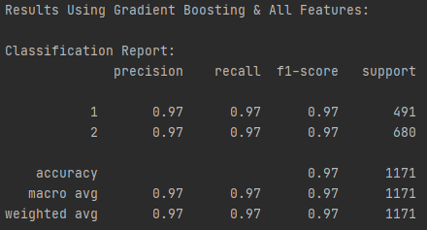

Gradient Boosting Classifier
Model 3 Specifications - Full Model
Standard gradient boosting classifier
Trained on full dataset
N estimators = 500
Learning rate = 0.05

Slide 17
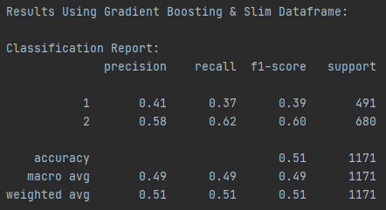
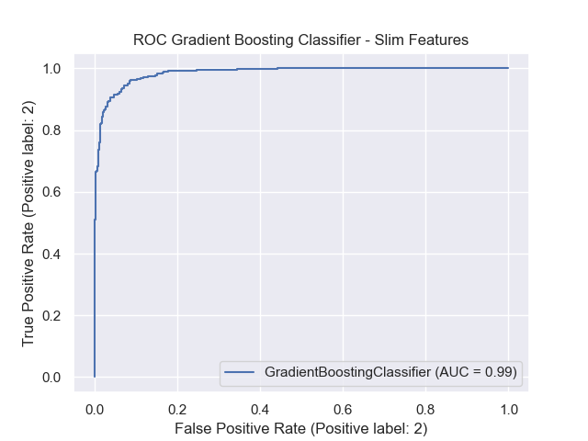
Gradient Boosting Classifier
Model 4 Specifications - Slim Model
Standard gradient boosting classifier
Trained on full dataset
N estimators = 500
Learning rate = 0.05

Slide 18
Results
05

Slide 19
Model Comparison
Model 1 Random Forest - Full Model | Model 2 Random Forest - Slim Model | Model 3 Gradient Boosting - Full Model | Model 4 Gradient Boosting - Slim Model
F1-score: 0.98 Accuracy score: 0.97 | F1-score: 0.93 Accuracy score: 0.93 | F1-score: 0.97 Accuracy score: 0.97 | F1-score: 0.50 Accuracy score: 0.51

Slide 20
Model Comparison
Model 1
Random Forest - Full Model
Model 3
Gradient Boosting - Full Model
Model 2
Random Forest - Slim Model

Slide 21
Conclusion
06

Slide 22
Conclusion
Using FiveThirtyEight survey data, we decided to predict who voters would vote for president based on their survey answers
We conducted exploratory data analysis to better understand the group of voters and make sure the classes were balanced
We preprocessed our data - label encoding, dropping columns and observations
We fit both random forest and gradient boosting models, and we ran on “full” and “slim” feature sets
We saw extremely high accuracy and f1 scores
Random forest did better than gradient boosting, and “full” feature models did better than “slim” feature models

Slide 23
Caveats
Although our models had high accuracy, the impact of our work is limited. Knowing how someone votes based on their opinion of Democrats and Republicans, view of police, view of systemic racism, etc. is not a novel finding. Predicting elections involves deciding how individuals will vote, while having much less information than we do here, as well as trying to predict turnout rates. A small, controlled sample cannot substitute for this.
Another question we could have considered is voter turnout. We could have set the target variable as whether someone planned to vote or not, then analyzed it by political affiliation, demographics, etc. This would get to the heart of this survey, which wanted to know why eligible voters don’t vote.

Slide 24
Citations
https://scikit-learn.org
https://numpy.org/
https://pandas.pydata.org/
https://pypi.org/project/PyQt5/
https://medium.com/analytics-vidhya/evaluating-a-random-forest-model-9d165595ad56
https://www.datasciencecentral.com/profiles/blogs/decision-tree-vs-random-forest-vs-boosted-trees-explained#:~:text=Like%20random%20forests%2C%20gradient%20boosting,one%20tree%20at%20a%20time
https://morningconsult.com/opinions/to-persuade-or-to-turn-out-voters-is-that-the-question/
https://www.bloomberg.com/graphics/2020-us-election-results/methodology

Slide 25
GUI Demonstration
07

Slide 26
GUI Demonstration
Insert GUI Demo vid

Slide 27
Thank you!

